Slide 1

DEPARTMENT OF COMPUTER SCIENCE AND ENGINEERING MAJOR PROJECT REVIEW ON AUDIO TO SIGN LANGUAGE TRANSLATOR USING MACHINE LEARNING
CMR TECHNICAL CAMPUS Accredited by NBA, Approved by AICTE, affiliated to
JNTUH Kandlakoya (V), Medchal Road, Hyderabad -501401
Under the guidance of G.POORNIMA
PRESENTED BY:
- APARNA AKULA(187R1A05C8)
-SUSHMITHA ANNAM(187R1A05D0)
-LAKSHMI BANTI(187R1A0D3)

Slide 2
Contents:
1)Abstract 2) Existing System 3) Disadvantages of Existing System 4) Proposed System 5) Advantages of Proposed System 6) Hardware Requirements 7) Software Requirements 8)Architecture
9)Modules
10)UML Diagrams
11)Sample code
12)Results
13)Conclusion
14)Future Enhancement

Slide 3
ABSTRACT
Deaf people always miss out the fun that a normal person does, may it be communication, playing computer games, attending seminars or video conferences, etc.
Communication is the most important difficulty they face with normal people and also every normal person does not know the sign language.
The aim of our project is to develop a communication system for the deaf people. It converts the audio message into the sign language.
This system takes audio as input, converts this audio recording message into text and displays the relevant Indian Sign Language images or GIFs which are predefined.
By using this system, the communication between normal and deaf people gets easier.

Slide 4
EXISTING SYSTEM
Existing solutions are we have physical devices and software which can convert audio to sign language but using Natural Language Processing we are improvising the tool.
The word library can be expanded to include most of the commonly used words in english. Speech to text conversion can be made more accurate and text processing can be optimized using various NLP algorithms.

Slide 5
DISADVANTAGES
It is not effective to use.
It is less accurate and secure.
Involving third person to communicate.

Slide 6
PROPOSED SYSTEM
Initially, we take audio as input on a Personal Digital Assistant (PDA) by utilizing the python pyaudio module next.
We convert the audio to text using the google speech API presently utilizing NLP i.e Natural Language Processing we breakdown the text into smaller, simpler and understandable text.
We have a reliance parser for analyzing the grammatical structure of the sentence and building up the connection between words by utilizing some Artificial Intelligence we can prepare a model and now we have data sets of predefined sign language and ISL generator can input sentences using ISL grammar rules.
By using Artificial Intelligence we can display the converted audio into the sign.
Finally, we converted audio into sign language

Slide 7
ADVANTAGES
To provide information access and services to deaf people in indian sign language.
To develop a scalable project which can be extended to capture whole vocabulary of isl through manual and non manual signs.
To improve the physical and mental well-being of the specially abled people and improve their overall quality of life.
It is accurate and secure.
Easy to use and adaptable by people.

Slide 8
HARDWARE REQUIREMENTS
Device(mobile/laptop)
Mic
Monitor to view output

Slide 9
SOFTWARE REQUIREMENTS
programming language: python3 , sql
packages used: nlp , python libraries (like django)
tools : Anaconda Prompt

Slide 10
ARCHITECTURE
start
audio
Convert to text
Search for that sentence in database
If word found
yes
Send video to the user
no
Break the sentence into words and fetch the videos of that words &combine them into a single video
Show the video
End

Slide 11
MODULES
User Module:In this module user will register with application and login with valid name and password and view all features like speech to text and sign language prediction.
Speech Recording Module:In this module google speech to text conversion library is used to convert voice to text and data is processed to next step for NLTK processing and text is displayed to user.
NLTK Module:In this module text is pre-processed by removing stop words and collect required words and send to next step to get required stored video based on that key word from system.
Sign language Display Module:Based on input from NLTK module text related videos are processed from the system and displayed to user when submit button is clicked.

Slide 12
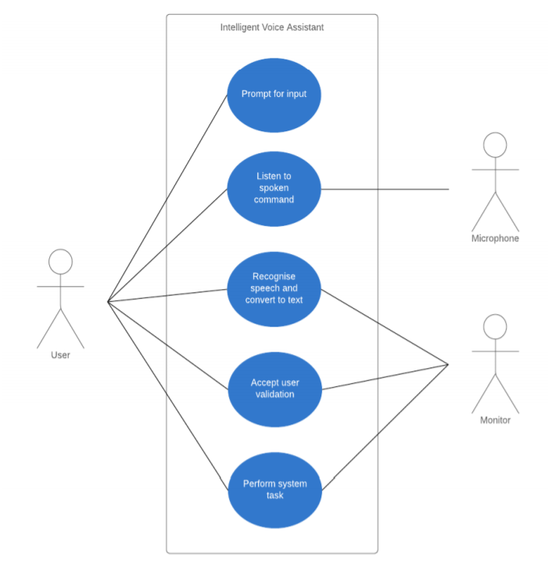
USE CASE DIAGRAM

Slide 13
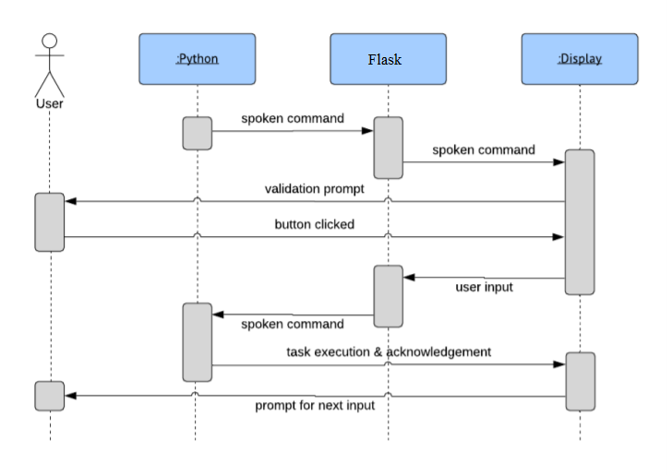
SEQUENCE DIAGRAM:

Slide 14
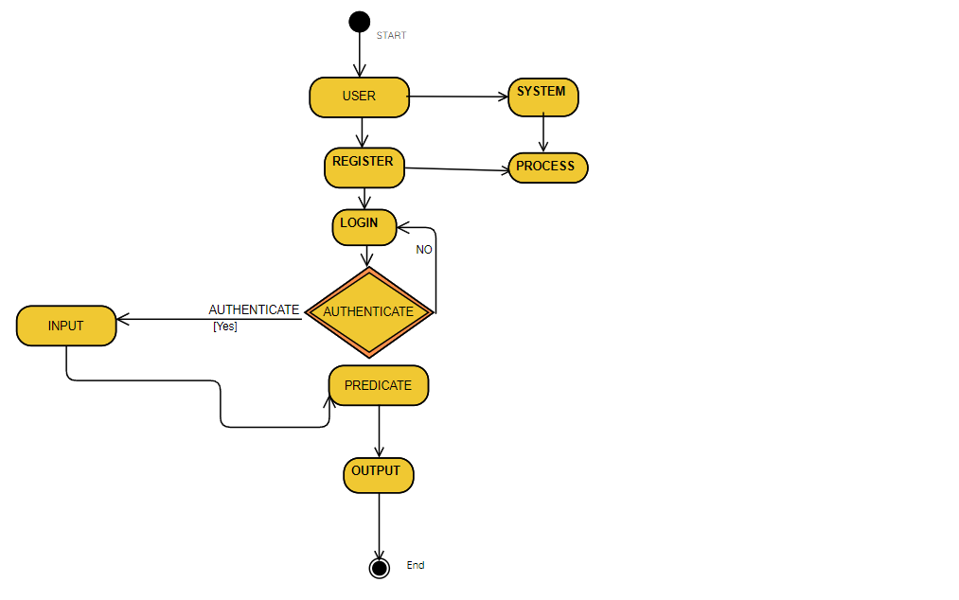
ACTIVITY DIAGRAM:

Slide 15
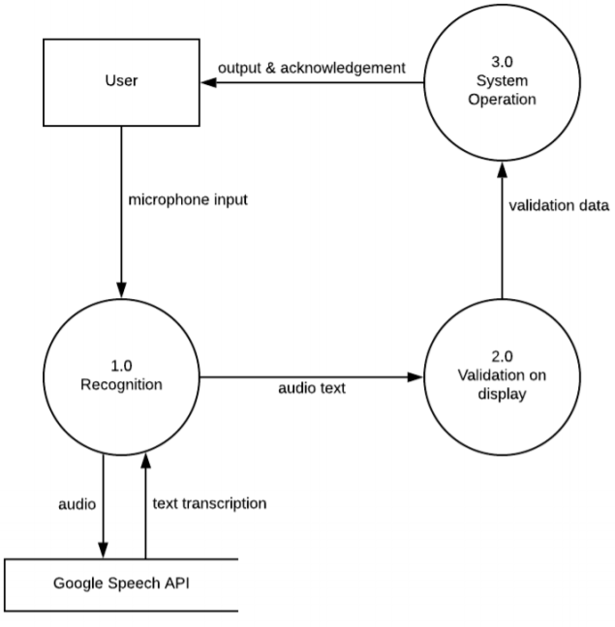
DATA FLOW DIAGRAM:

Slide 16
Sample code:
from django.http import HttpResponse
from django.shortcuts import render, redirect
from django.contrib.auth.forms import UserCreationForm, AuthenticationForm
from django.contrib.auth import login,logout
from nltk.tokenize import word_tokenize
from nltk.corpus import stopwords
from nltk.stem import WordNetLemmatizer
import nltk
from django.contrib.staticfiles import finders
from django.contrib.auth.decorators import login_required

Slide 17
@login_required(login_url="login")
def animation_view(request):
if request.method == 'POST':
text = request.POST.get('sen')
#tokenizing the sentence
text.lower()
#tokenizing the sentence
words = word_tokenize(text)
tagged = nltk.pos_tag(words)
tense = {}
tense["future"] = len([word for word in tagged if word[1] == "MD"])
tense["present"] = len([word for word in tagged if word[1] in ["VBP", "VBZ","VBG"]])
tense["past"] = len([word for word in tagged if word[1] in ["VBD", "VBN"]])
tense["present_continuous"] = len([word for word in tagged if word[1] in ["VBG"]])

Slide 18
#stopwords that will be removed
stop_words = set(["mightn't", 're', 'wasn', 'wouldn', 'be', 'has', 'that', 'does', 'shouldn', 'do', "you've",'off', 'for', "didn't", 'm', 'ain', 'haven', "weren't", 'are', "she's", "wasn't", 'its', "haven't", "wouldn't", 'don', 'weren', 's', "you'd", "don't", 'doesn', "hadn't", 'is', 'was', "that'll", "should've", 'a', 'then', 'the', 'mustn', 'i', 'nor', 'as', "it's", "needn't", 'd', 'am', 'have', 'hasn', 'o', "aren't", "you'll", "couldn't", "you're", "mustn't", 'didn', "doesn't", 'll', 'an', 'hadn', 'whom', 'y', "hasn't", 'itself', 'couldn', 'needn', "shan't", 'isn', 'been', 'such', 'shan', "shouldn't", 'aren', 'being', 'were', 'did', 'ma', 't', 'having', 'mightn', 've', "isn't", "won't"])
#removing stopwords and applying lemmatizing nlp process to words
lr = WordNetLemmatizer()
filtered_text = []
for w,p in zip(words,tagged):
if w not in stop_words:
if p[1]=='VBG' or p[1]=='VBD' or p[1]=='VBZ' or p[1]=='VBN' or p[1]=='NN':
filtered_text.append(lr.lemmatize(w,pos='v'))
elif p[1]=='JJ' or p[1]=='JJR' or p[1]=='JJS'or p[1]=='RBR' or p[1]=='RBS':
filtered_text.append(lr.lemmatize(w,pos='a'))
else:
filtered_text.append(lr.lemmatize(w))

Slide 19
#adding the specific word to specify tense
words = filtered_text
temp=[]
for w in words:
if w=='I':
temp.append('Me')
else:
temp.append(w)
words = temp
probable_tense = max(tense,key=tense.get)
if probable_tense == "past" and tense["past"]>=1:
temp = ["Before"]
temp = temp + words
words = temp
elif probable_tense == "future" and tense["future"]>=1:
if "Will" not in words:
temp = ["Will"]
temp = temp + words
words = temp

Slide 20
else:
pass
elif probable_tense == "present":
if tense["present_continuous"]>=1:
temp = ["Now"]
temp = temp + words
words = temp
filtered_text = []
for w in words:
path = w + ".mp4"
f = finders.find(path)
#splitting the word if its animation is not present in database
if not f:
for c in w:
filtered_text.append(c)
#otherwise animation of word
else:
filtered_text.append(w)
words = filtered_text;

Slide 21
return render(request,'animation.html',{'words':words,'text':text})
else:
return render(request,'animation.html')
def signup_view(request):
if request.method == 'POST':
form = UserCreationForm(request.POST)
if form.is_valid():
user = form.save()
login(request,user)
# log the user in
return redirect('animation')
else:
form = UserCreationForm()
return render(request,'signup.html',{'form':form})

Slide 22
def login_view(request):
if request.method == 'POST':
form = AuthenticationForm(data=request.POST)
if form.is_valid():
#log in user
user = form.get_user()
login(request,user)
if 'next' in request.POST:
return redirect(request.POST.get('next'))
else:
return redirect('animation')
else:
form = AuthenticationForm()
return render(request,'login.html',{'form':form})
def logout_view(request):
logout(request)
return redirect("home")

Slide 23
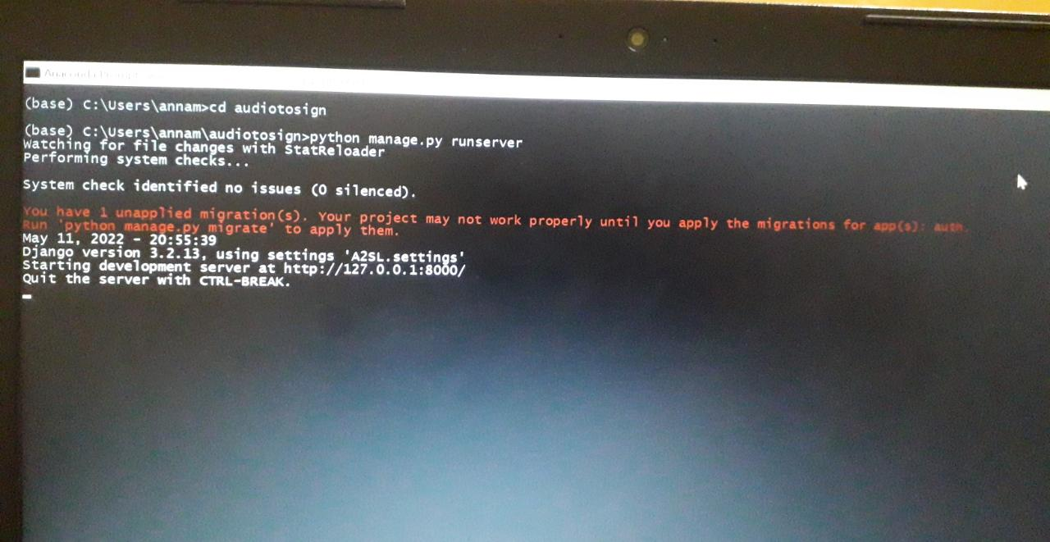
RESULTS
Command Prompt:
open anaconda prompt from search and type
conda activate tf ( enter )
And again type
cd audiotosign ( enter )
Type python manage.py runserver
you will get ip address copy and pste in chrome website will open(http://127.0.0.1:8000/)

Slide 24
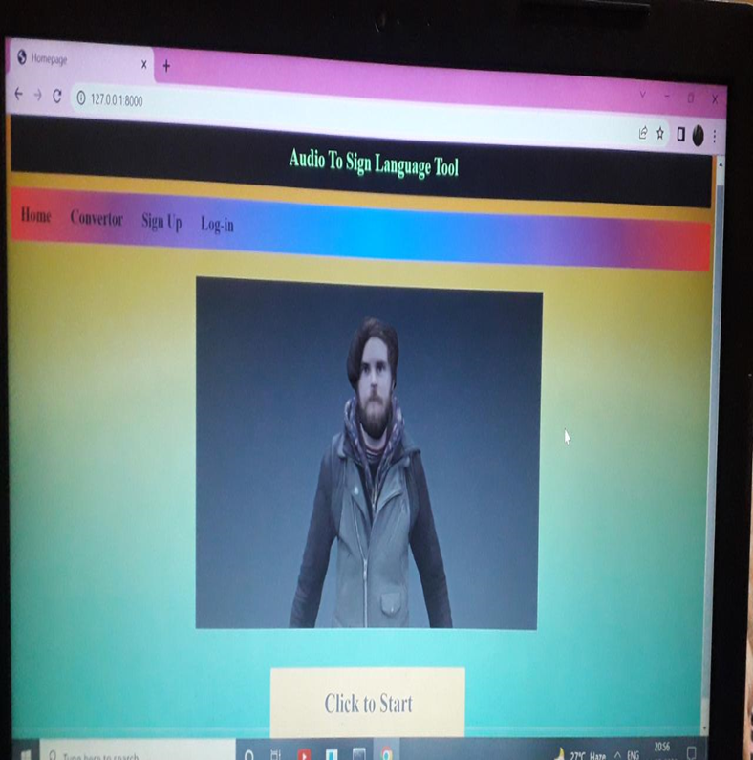
HOME PAGE

Slide 25
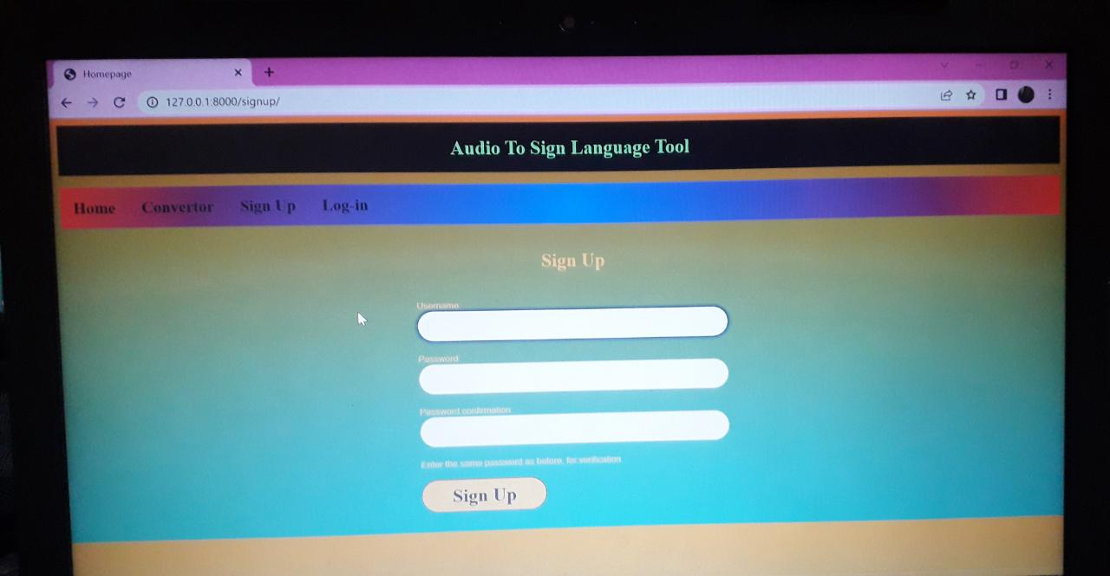
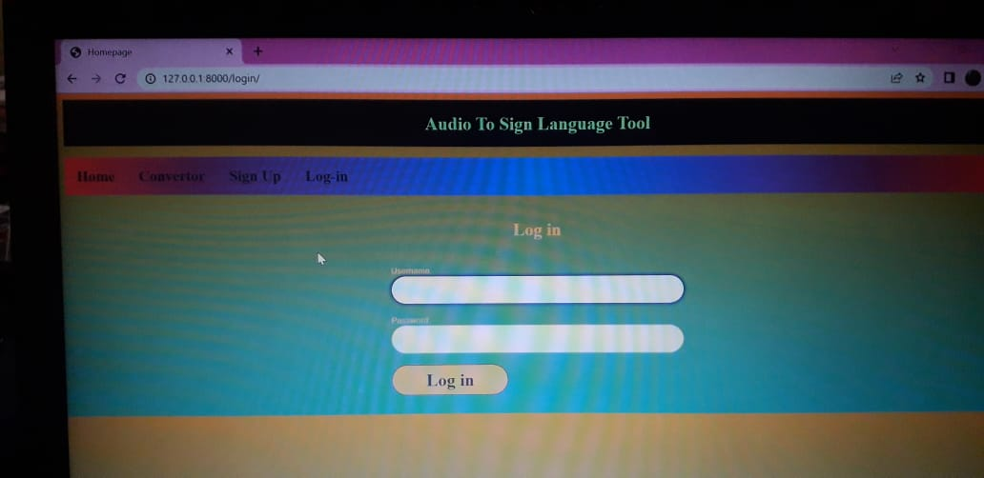
SIGN UP PAGE
LOGIN PAGE

Slide 26
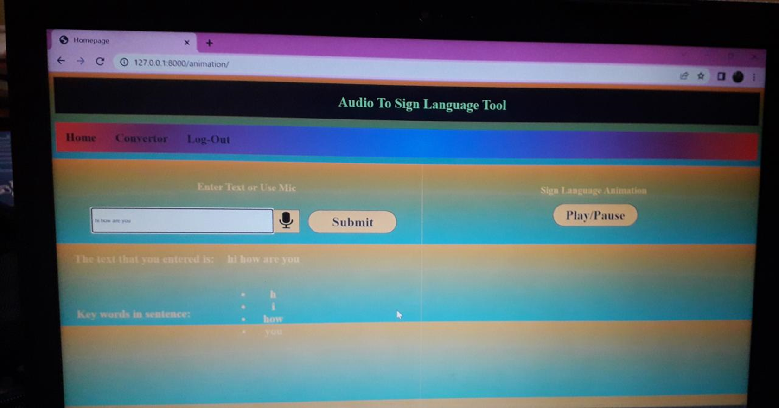
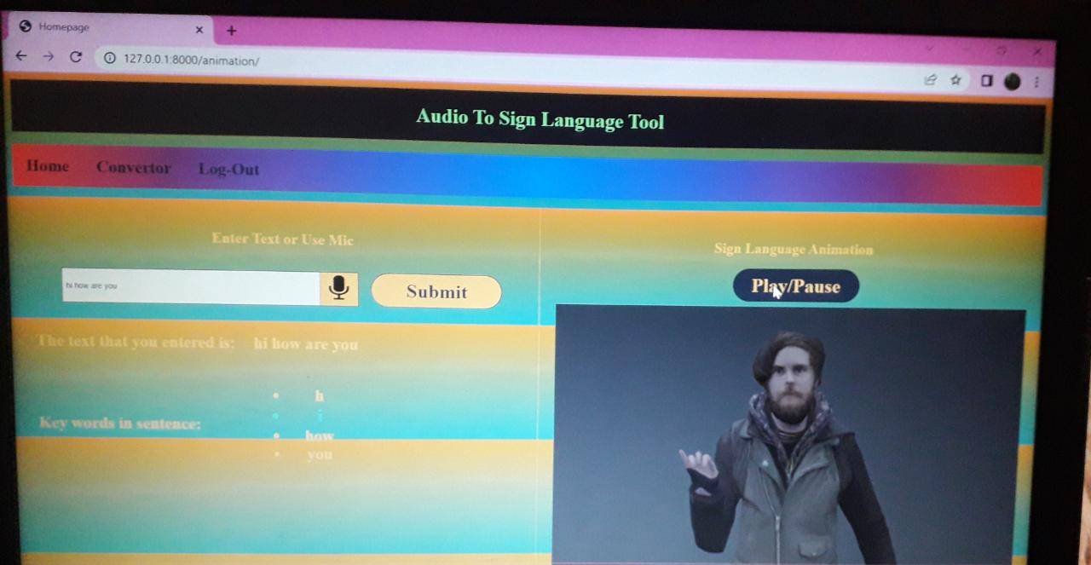
ANIMATION PAGE

Slide 27
CONCLUSION
Sign language translator is very useful in various areas. In schools, colleges, hospitals, universities, airports, courts anywhere anyone can use this system for understanding of a the sign language to communicate. It makes communication between a normal hearing person and a hard to hearing person easier.
Understanding the requirements needed by the impaired community and finding a solution to them in making a difference.
To improve the physical and mental well-being of the specially abled people and improve their overall quality of life .

Slide 28
FUTURE ENHANCEMENT
The future work is to develop an application where in the news channels can use it while giving news, in one corner of the screen it will be displayed in sign language for deaf people.
Write now only DD news is using this kind of presentation but they are using a human being showing signs according to the speech of the person giving news live.
So this will be better idea which we can give to news channels. We look forward to expand the project by also including facial expressions into the system.

Slide 29
THANK YOU

